Slide 1
Physiological Basis for certain clinical findings …..
Understand to unravel

Slide 2
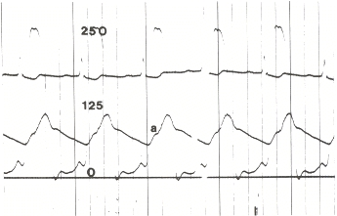
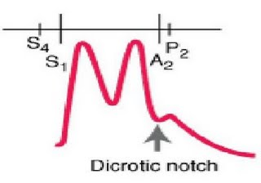
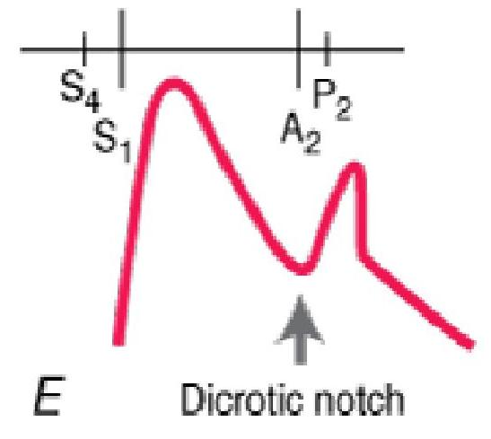
ABNORMAL TYPES OF ARTERIAL PULSE
Anacrotic ( Ana = up ; Krotos = beat )
Dicrotic ( Di = twice ; Krotos = beat )
Bisferiens ( Bis = twice ; feriere = beat )

Slide 3
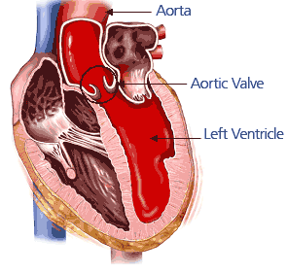
BISFERIENS PULSE
CHRONIC SEVERE AR
AS & AR ( of atleast moderate severity )
HOCM

Slide 4
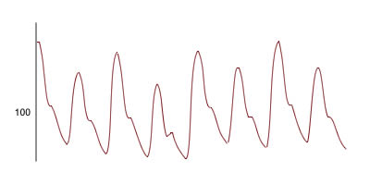
Pulsus Alternans

Slide 5
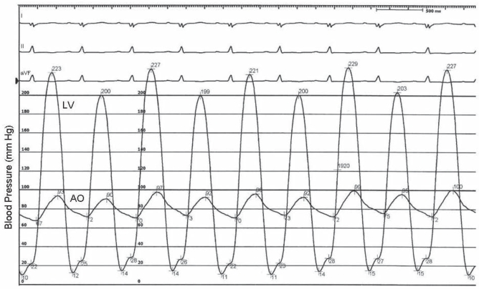

Slide 6
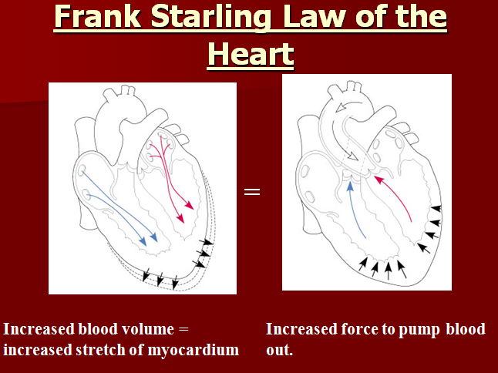
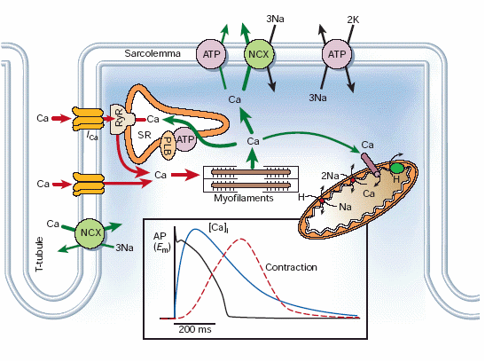

Slide 7
PULSUS PARADOXUS
“Exaggerated inspiratory decline in systolic AP”
How to elicit ?
Quiet breathing – no Valsalva
Feel the pulse with varying pressure
Cuff BP – diffference between the value at which the sounds are heard only in expiration and at the value at which sounds are heard in both phases
exp insp exp insp exp insp exp insp
120 110 100 86

Slide 8
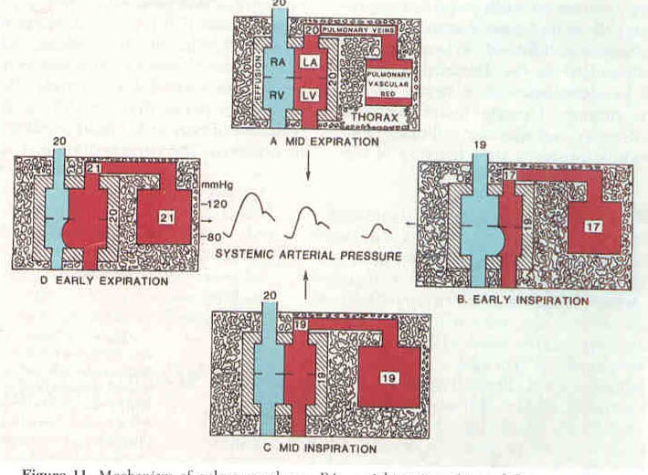

Slide 9
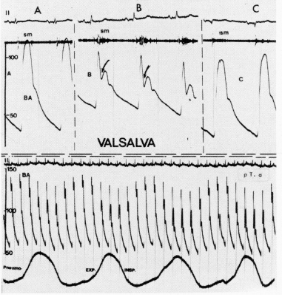
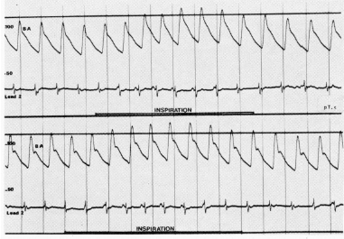
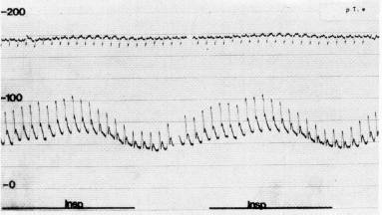
REVERSED PULSUS PARADOXUS
HOCM, ISORHYTHMIC AV DISSOCIATION,
POSITIVE PRESSURE VENTILATION IN HF

Slide 10
HILL’S SIGN
Leonard Hill ( English physiologist ) 1909 Lower extremity pressures higher than upper extremity pressure in Aortic Regurgitation – observed by his assistant W.Holtzmann
Popliteal systolic pressure > brachial by atleast 20 mm Hg
Sensitivity 71-100% Specificity 75-100%
Intra arterial pressures are not different

Slide 11
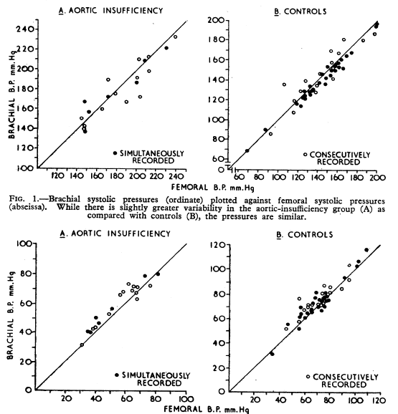
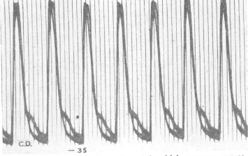
Arm & Leg BP in AR
E F Pascarelli
BHJ 1965:2;73

Slide 12
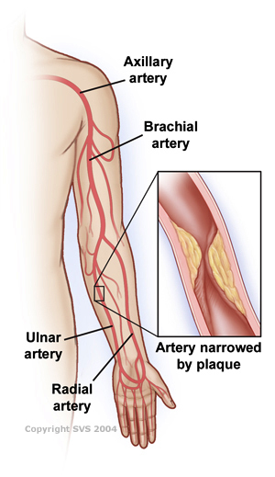

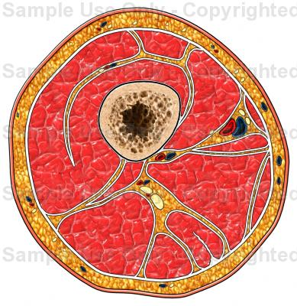
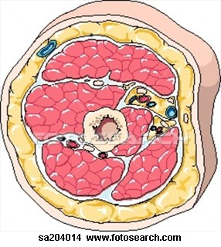
R

Slide 13
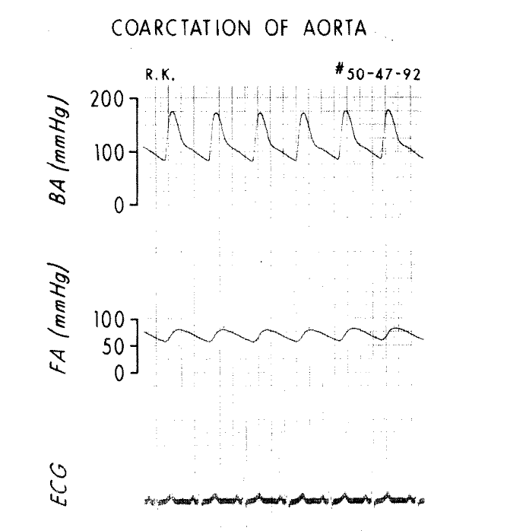
Brachio femoral or Radio femoral delay ?
Delay in onset of pulse, as it travels to periphery
Carotid = 30ms, Brachial = 60ms,
Radial = 80 ms, Femoral = 75 ms
It is the slow upstroke and delayed peak rather than
the delayed onset that gives
the tactile feeling
Difficult to feel radial in children – Brachiofemoral delay ;
In adults radiofemoral or brachiofemoral

Slide 14
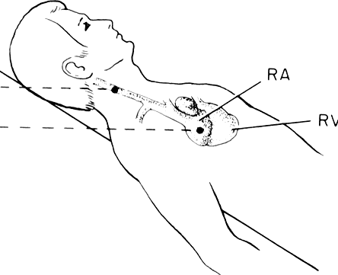
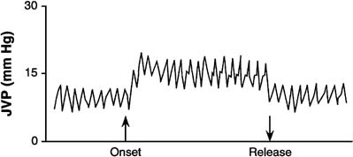
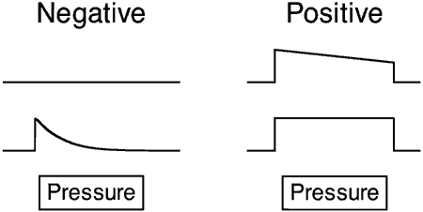
ABDOMINO JUGULAR REFLUX
↓ RV compliance
RV dysfunction
PAH, RVMI
Constriction, RCM
Elevated PAWP

Slide 15
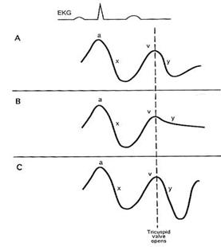
Jugular Venous Pulse in
Pericardial Diseases
NORMAL :
X > Y
TAMPONADE :
X steep Y shallow
CONSTRICTION :
X & Y steep

Slide 16
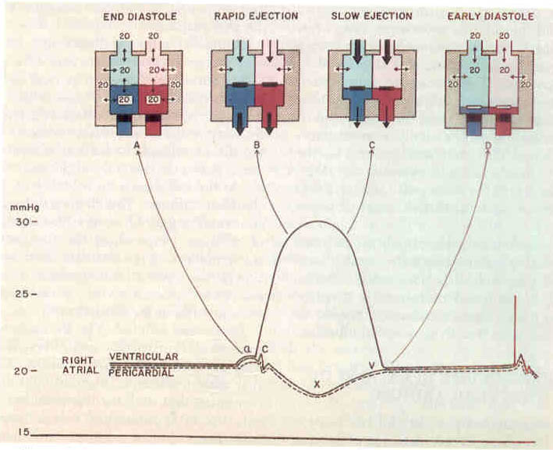

Slide 17
TAMPONADE ~ CONSTRICTION
SIMILARITIES :
↑FP OF VENTRICLES ; ↑AP ; ↑ VENOUS PRESSURES
EXAGGERATION OF LV, RV FILLING PATTERNS DURING RESPIRATION
ELEVATION AND EQUALIZATION OF PRESSURES IN CHAMBERS
        ↓SV ↓ CO ↑ HR
DISSIMILARITIES :
ED Dip V.P PP VENOUS FLOW
TAMPONADE X X √ UNIMODAL
CONSTRICTION PROMINENT + X BIMODAL
Notes:
S

Slide 18
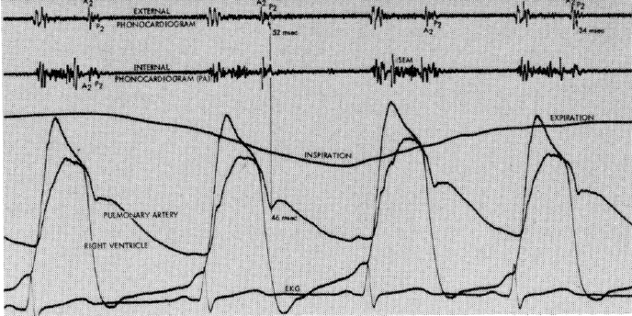
PHYSIOLOGICAL SPLIT OF S2

Slide 19
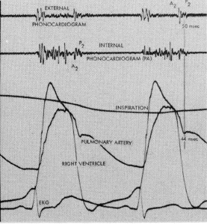
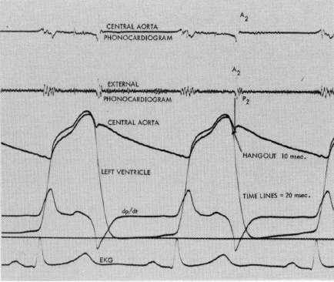
HANG OUT INTERVAL

Slide 20
S2 IN PULMONARY HYPERTENSION
In SHT, increasing pressure leads to
delayed A2 and even paradoxical split
But in PAH, S2 split narrows down, atleast
in the early phase
WHY ?

Slide 21
S2 IN PULMONARY HYPERTENSION
Hang out interval - Pulmonary : 30 – 90 ms
- Aortic : 5 - 10 ms
In pulmonary circulation, there is a reserve which gets depleted when pressure rises ; but in systemic circulation there is no reserve
S2 split narrows in the early phase – becomes wider with RV dysfunction ( ↑ RV mechanical systole )

Slide 22
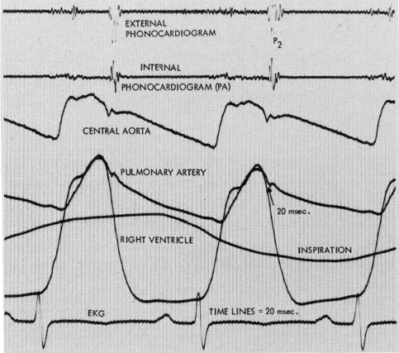
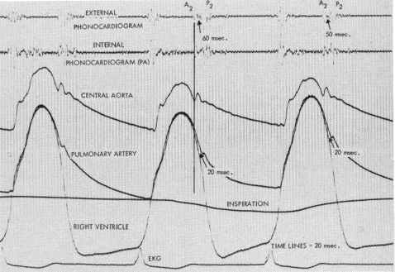
S2 IN PULMONARY HYPERTENSION

Slide 23
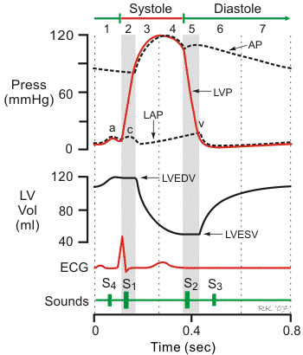
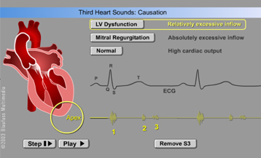
Third Heart Sound
caused by augmented rapid filling of ventricle
Physiological: Compliant LV but rapid flow
Pathological: Noncompliant LV + High LAP – HF
Moderate to large volume overload

Slide 24
S 3 is a feature of
LV dysfunction – Systolic / Diastolic
Acute coronary syndromes
LV volume overload state :
MR, VSD, PDA
High output states anemia, pregnancy,
hyperthyroidism, AV fistula
Children & Adolscents, Athletes

Slide 25
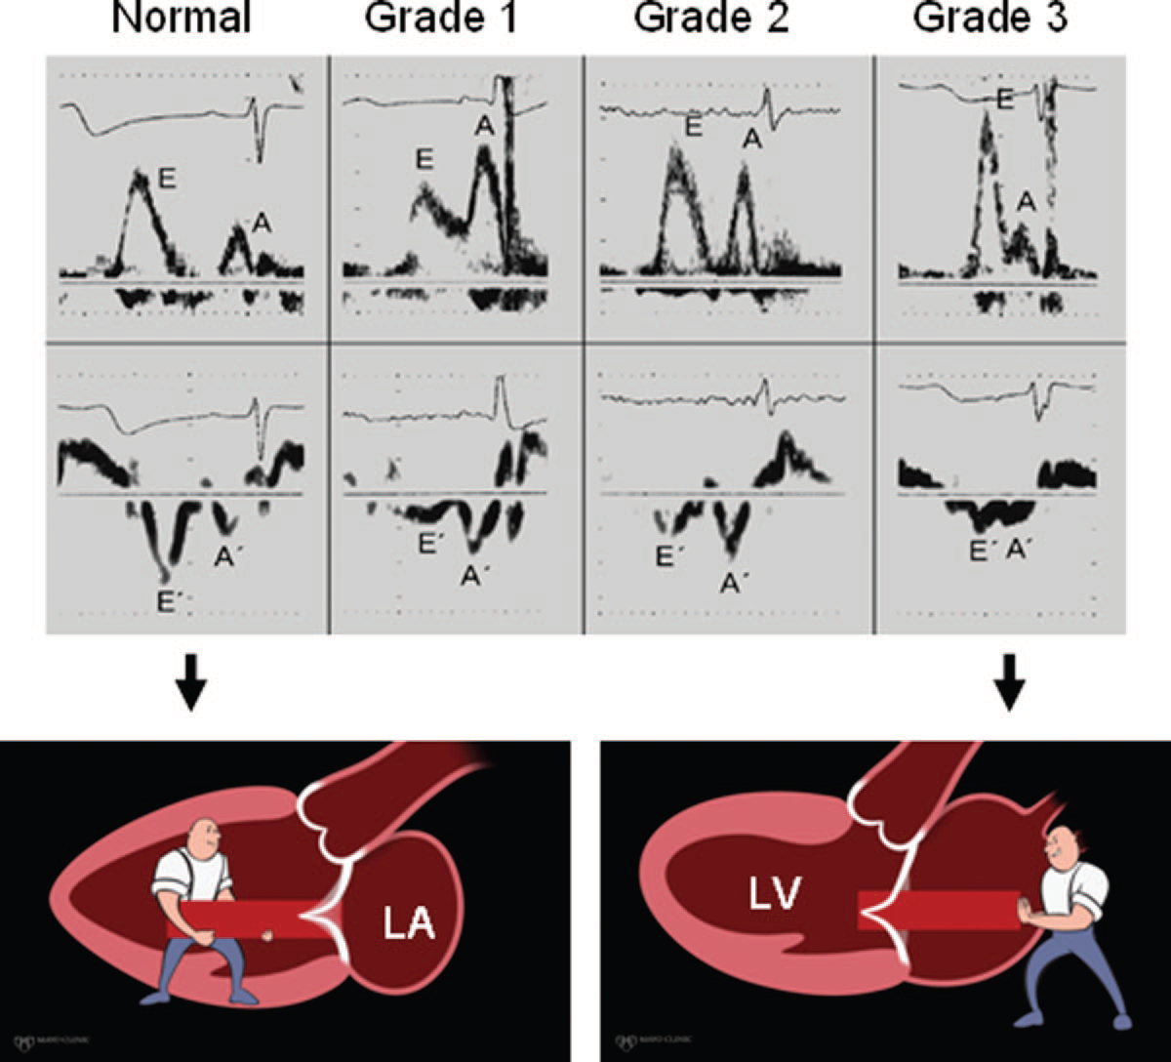

Slide 26
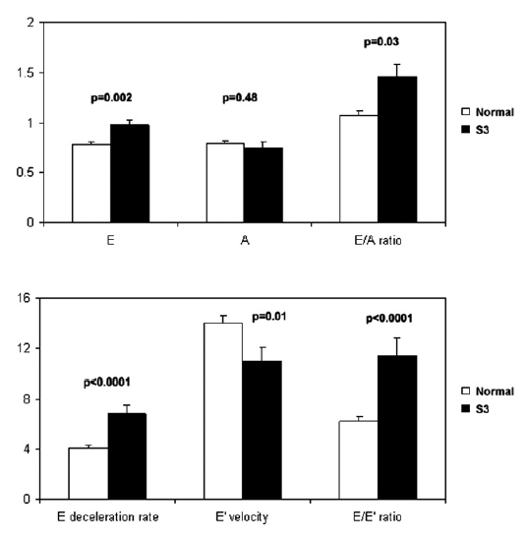
Mechanism of S3 – Doppler study
S J Shah JASE 2007
Presence & Intensity
of S3 correlates with
Amplitude of E
E/A ratio
Deceleration rate
E/e’ ratio
LA volume

Slide 27
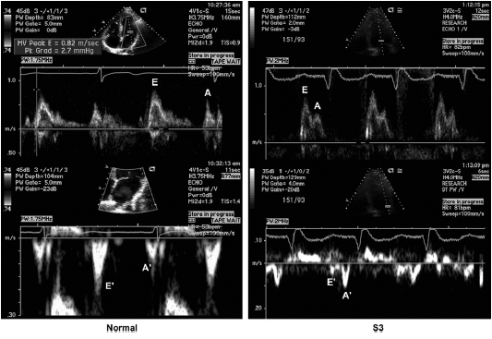

Slide 28
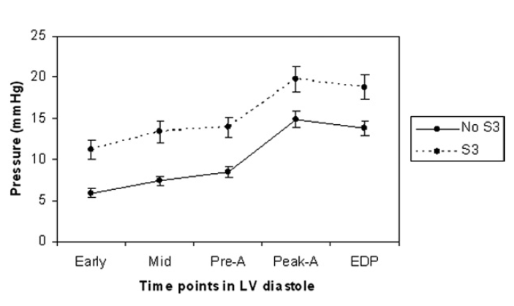

Slide 29
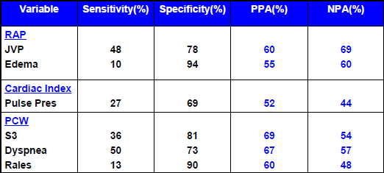

Slide 30
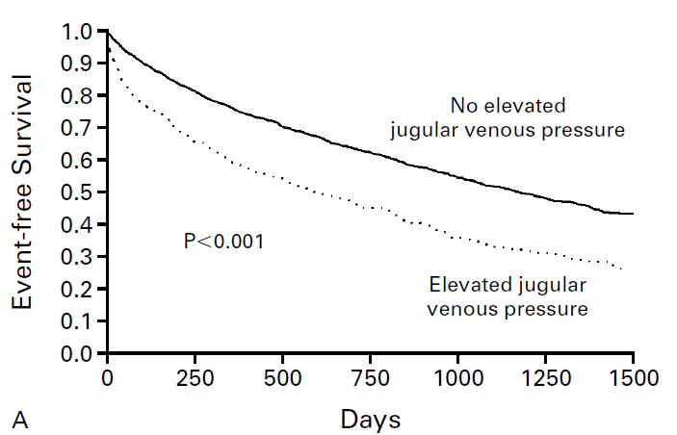
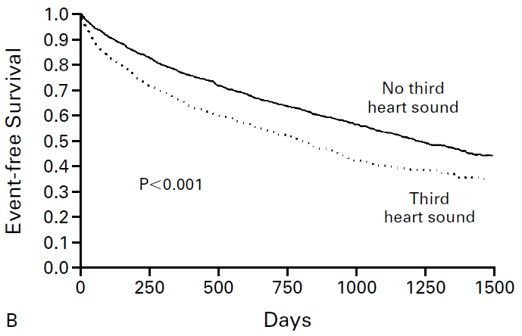
Prognostic Implication of
S3 & ↑ JVP in acute HF
M H Drazner N Engl J Med 2001; 345:574
↑ JVP S3
HF adm 1.32 1.42
HF Death 1.37 1.40
Death 1.15 1.15

Slide 31
S3 in Chronic AR
EDVI ESVI EF LVEDP LVSP
ml/m² ml/m2 % mmHg ESV
Normal 82 28 65 9 4.04
±16 ±7 ±0.05 ±3 ±0.55
AR – S3 158 48 70 11 3.24
±36 ±14 ±0.08 ±6 ±0.82
AR + S3 206 97 53 17 1.57
±48 ±36 ±0.01 ±8 ±0.71
AM Abdulla Circulation 1981;64;464-471

Slide 32
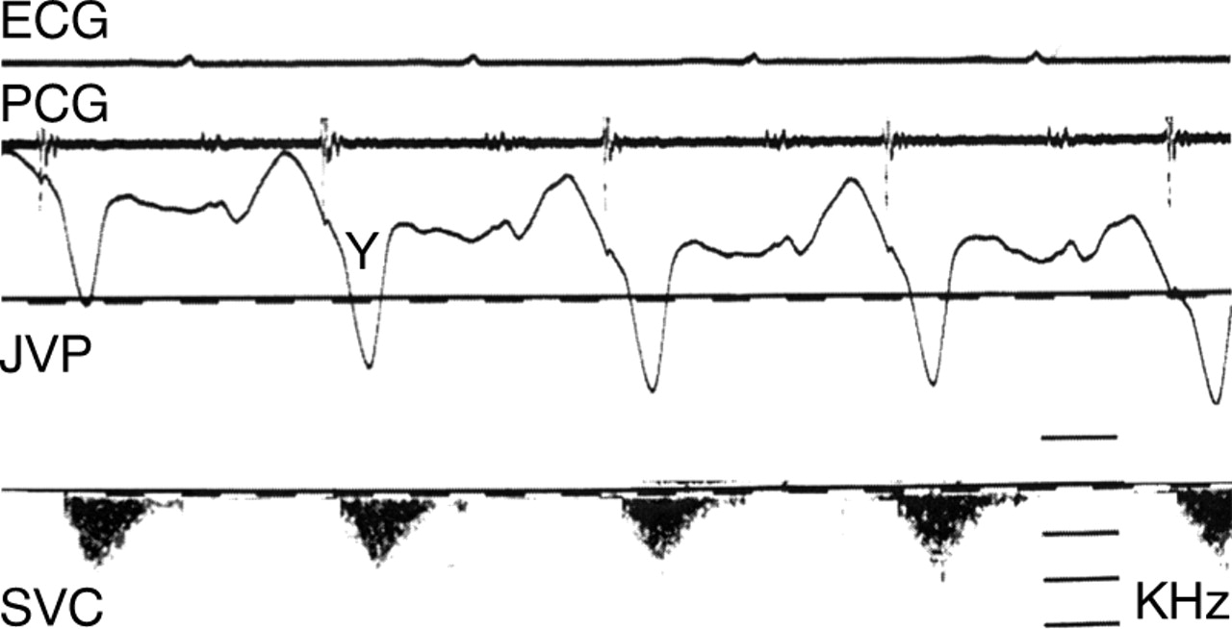
PERICARDIAL KNOCK

Slide 33
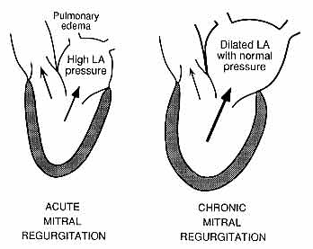
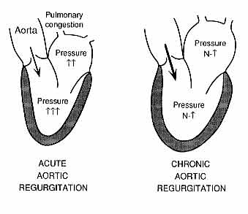
Acute severe Valvular Regurgitations
Acute severe MR - Class IV dyspnea,
Decrescendo systolic murmur, S4, PAH
Acute severe AR – Class IV dyspnea,Tachycardia,
Soft S1 and absence of S4

Slide 34
MITRAL REGURGITATION
CHRONIC ACUTE
H/O Murmur Long period Recent
Heart Failure None / Mild Severe
Murmur of MR
Frequency High Medium
Fourth sound No Yes
Features of PH No Yes

Slide 35
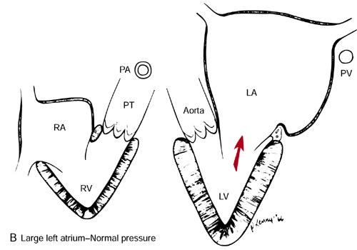

Slide 36
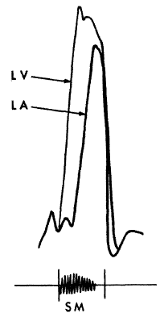
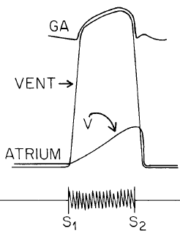
ACUTE
Infective endocarditis
Chordal rupture
Trauma
Iatrogenic
Ischemic
CHRONIC

Slide 37
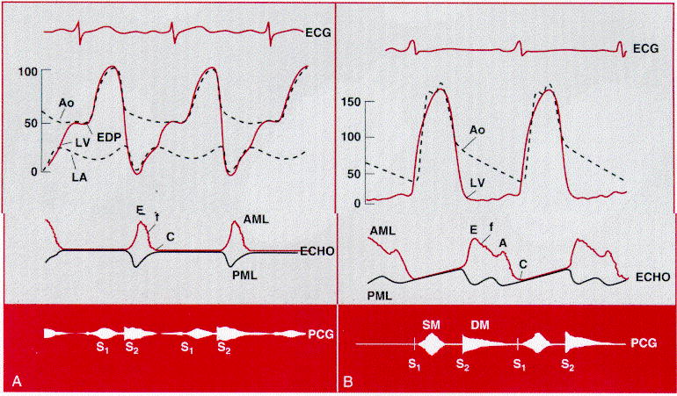

Slide 38
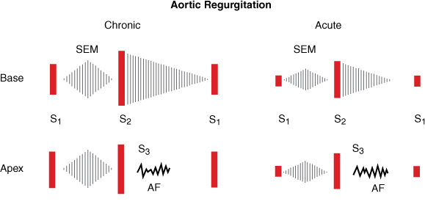

Slide 39
AORTIC REGURGITATION
ACUTE CHRONIC
Heart failure Rapid Insidious
Arterial Pulse Fast Normal
Alternans Bisferiens
Pulse pressure Normal Wide
Apical impulse Normal Hyperdynamic
First heart sound Soft Normal
Second heart sound A2↓P2↑ Normal
Third heart sound Usual In LVD
Fourth heart sound Absent May occur
AR murmur Intensity & Pitch Short, medium Long, High
Austin Flint murmur MDM MDM ± PSM

Slide 40
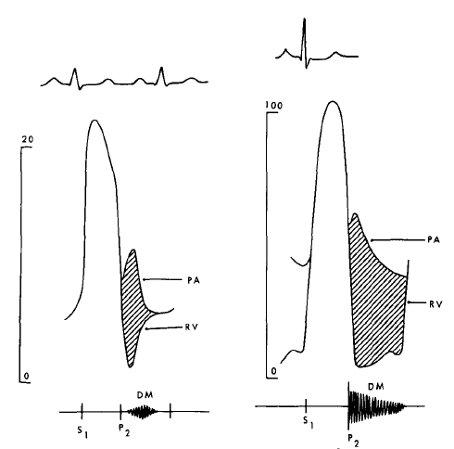
PULMONARY REGURGITATION
PAH
NO PAH

Slide 41
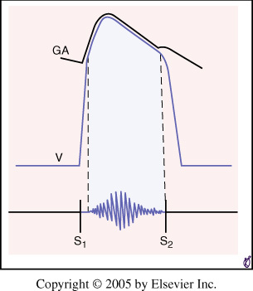
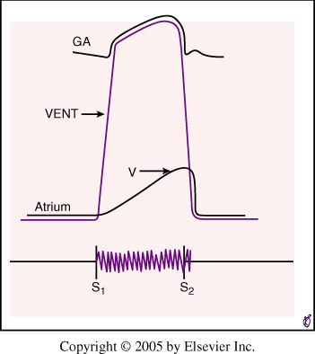
SYSTOLIC MURMURS
EJECTION (MIDSYSTOLIC ) REGURGITANT (HOLOSYSTOLIC)

Slide 42
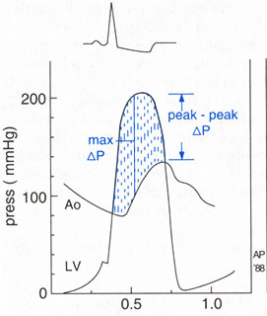
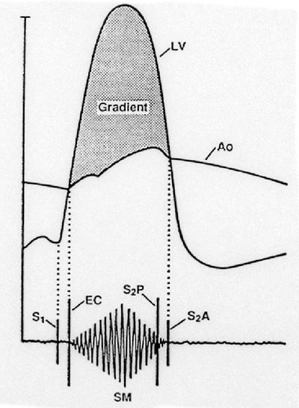

Slide 43



Slide 44



Slide 45


Presystolic Impulse in Aortic Stenosis
M A Kavalier ; Circulation 1975;51;324-327
S4 86% ↑ a in none
S4 in 85% ↑ a in 45%

Slide 46
LV OUTFLOW OBSTRUCTION
Valvular Supravalvular Discrete HOCM
subaortic
Arterial pulse Anacrotic unequal Anacrotic Jerky
Bisferiens
Post VPD PP ↑ ↑ ↑ ↓
Ejection sound + - - -
Murmur site 2 RICS 1 RICS L III ICS L III-IV ICS
AR murmur + - + -
Murmur –Valsalva ↓ ↓ ↓ ↑
CXRay Asc AO ↑ - - -
Valve Ca + - - -

Slide 47
AORTIC STENOSIS IN ELDERLY
Co existence with hypertension
Arterial pulse deceptive, due to inelastic arteries
Murmur may not be louder – barrel chest
Murmur may be best heard at apex
Gallavardin phenomenon
Rapid progression

Slide 48



Aortic Stenosis HOCM

Slide 49

↑Afterload,↑Preload,↓Contractility
↓Afterload,↓Preload,↑Contractility

Slide 50



Slide 51


Slide 52
Cycle Length Variation
Post premature beat / Long cycle short cycle of AF
Post VPD / Long > Short cycle of AF :
Outflow murmurs ( AS/PS) accentuate
Regurgitant murmurs do not change

Slide 53




Slide 54


Slide 55
MITRAL STENOSIS - SEVERITY
MILD MODERATE SEVERE
Mean gradient mmHg < 5 5 – 10 10
Valve area cm² > 1.5 1 – 1.5 < 1.0
PA SP mm Hg < 30 30 - 50 > 50
CLINICAL APPROACH
S2-OS INTERVAL ms > 90 60 -90 < 60
LENGTH OF MDM : A gap between MDM & PSM > mild
IN AF: S2-OS interval proportional to preceding cycle length
Presence of presystolic m in long cycles > severe MS
Fixed S2-OS interval in AF > rigid valve

Slide 56
S2 – OS INTERVAL
Varies with cycle length – Tachycardia > Narrow
AF – preceding cycle
Wider interval in SHT, AR, Low HR / CO, Stiff Ca
Narrow interval in coexistent MR
Absent in calcified valve
May occur in the absence of MS
MR, PDA, VSD, Tricuspid atresia, AV Block,
HOCM, BT shunt, Thyrotoxicosis
ASD, TR ( tricuspid )

Slide 57


PRESYSTOLIC MURMUR IN M.S

Slide 58

Presystolic murmur in M.S with A.F

Slide 59


Slide 60


TRICUSPID STENOSIS

Slide 61


Slide 62
MITRAL TRICUSPID
STENOSIS STENOSIS
Diastolic murmur MDM + PSA MDM in AF
PSM in SR
Low pitched Medium pitch
Better in Exp ↑ in Inspiration
Apex LLSB
Opening snap Loud, In faint, LLSB, late
between ↑ by inspiration
LLSB & APEX

Slide 63


Austin Flint Murmur
Presystolic : Moderate AR
Midiastolic & Presystolic : Severe AR
N LV function
Middiastolic : Chronic severe AR + LV dysf
Acute severe AR

Slide 64
Carvallo’s sign
Inspiratory accentuation of TR murmur
Early systolic murmur > holosystolic
Blowing quality > musical
Absent in severe RV failure
associated TS is severe
If venous pressure is very high, listening in upright posture may help

Slide 65

Reversed Carvallo sign
HCM with RVO obstruction - ? ↑ VR > widened RVO

Slide 66


Isometric Hand Grip
HAND DYNAMOMETER

Slide 67





Slide 68


Physiological changes
of
ISOMETRIC
HANDGRIP
EXERCISE

Slide 69
Isometric Hand Grip
LV S3 & S4 get augmented
Murmurs of MR,AR,VSD intensify
Mitral stenotic murmur may augment
Systolic murmur of HOCM may diminish
Click & late sytolic murmur of MVP get delayed

Slide 70

Squatting
Increased venous return and CO > augments most murmurs atleast initially (AS,PS,MR,AR,VSD) Right heart murmurs do so earlier
Increased ventricular volume > murmur of HOCM ↓ murmur of MVP ↓→
Ejection murmur of TOF ↑

Slide 71


P Hanson
Br HeartJ7 1995;74:154

Slide 72

Central Aortic Pressure
T Murakami
AHJ 2002; 15:986–988

Slide 73

Hemodynamics of Squatting
T Murakami AHJ 2002; 15:986–988

Slide 74


T Murakami
AHJ 2002; 15:986–988

Slide 75
Valsalva Maneuver
Reduces the intensity of all murmurs except that of HOCM & MVP
Murmur of HOCM intensifies as the LV cavity size decreases
Click occurs earlier, the murmur lengthens in MVP – may not intensify
During release, the intensity of right heart murmurs returns earlier - 1 to 3 vs 5 beats for left heart murmurs

Slide 76


Slide 77
↑Afterload,↑Preload,↓Contractility
↓Afterload,↓Preload,↑Contractility

Slide 78


Slide 79


Valslava

Slide 80


Slide 82


Slide 83


Slide 84


Slide 85



Slide 86


Slide 87


Slide 88


Valsalva Maneuver
Decreased venous return & CO, HR ↑; PP↓
S2 split narrows down, S3 & S4 diminish

Slide 89

VALSALVA STRAIN

Slide 90

ASD, HF, MS

Slide 91


Slide 93



Slide 94


Slide 95


RESTRICTIVE PHYSIOLOGY
A HEMODYNAMIC SITUATION CHARACTERIZED BY
IMPEDIMENT OF FILLING OF VENTRICLES
DUE TO
INCREASED VENTRICULAR STIFFNESS
PERICARDIAL CONSTRAINT

Slide 96

RESTRICTIVE PHYSIOLOGY
LV
RV
LV
RA

Slide 97



RESTRICTIVE CONSTRICTIVE CARDIOMYOPATHY PERICARDITIS
RIGHT HEART FAILURE
PRESERVED SYSTOLIC FUNCTION
ELEVATED JVP WITH STEEP X & Y
GRADE III DD ; DIASTOLIC MR / TR PREMATURE PV OPENING
ELEVATED & EQUALIZED VENTRICULAR PRESSURES & DIP & PLATEAU PATTERN

Slide 98
RESTRICTIVE PHYSIOLOGY
RESTRICTIVE CARDIOMYOPATHY CONSTRICTIVE PERICARDITIS
IDIOPATHIC / SECONDARY SUBACUTE ( ELASTIC)
AMYLOIDOSIS CHRONIC ( CALCIFIC )
SARCOIDOSIS ● CONGENITAL:MULIBREY NANISM
HEMOCHROMATOSIS ● INFLAMMATORY : INFECTIONS;
EOSINOPHILIC ENDOCARDITIS VIRAL; TB; AUTOIMMUNE
ENDOMYOCARDIAL FIBROSIS ● IRRADIATION
ENDOCARDIAL FIBROELASTOSIS ● RENAL FAILURE
ENDSTAGE HCM, DCM ● MYOCARDIAL INFARCTION
● MALIGNANCY
● TRAUMA
● SUGERY / INTERVENTION

Slide 99
VALVULAR :
Loud murmurs ± gallops / opening sounds
MYOCARDIAL :
Faint or no murmurs + Loud gallops
PERICARDIAL :
No murmurs, No gallops

Slide 100




CONSTRICTIVE PERICARDITIS RESTRICTVE CARDIOMYOPATHY
LVEDP – RVEDP < 5 mm Hg
RVEDP > 1/3 of RVSP
PASP < 55 m Hg
NO RESP. VARIATION OF RAP
LV RFW > 7 mm Hg

Slide 101
SENSITIVITY & SPECIFICITY OF
HEMODYNAMIC CRITERIA IN DIAGNOSING C.P
FEATURE SENSITIVITY% SPECIFICITY%
LVEDP – RVEDP < 5mm Hg 60 38
RVEDP / RVSP > 1/3 93 38
PA SP < 55 mm Hg 93 24
LV RFW > 7 mm Hg 93 57
RESPIRATORY ~ RAP < 3mm Hg 93 48
RESPIRATORY ~ PAWP – LV PG > 5mm Hg 93 81
LV – RV INTERDEPENDENCE 100 95
D G HURRELL CIRCULATION 1996

Slide 102

VALUE OF
CONVENTIONAL
HEMODYNAMIC
CRITERIA
TO
DIFFERENTIATE
CP ~ RCM
CONSIDERABLE OVERLAP
D G HURRELL CIRCULATION 1996

Slide 103
HEMODYNAMIC HALLMARKS OF
CONSTRICTIVE PERICARDITIS
PROMINENT VENTRICULAR INTERACTION &
RECIPROCAL RELATIONSHIP OF
RV ~ LV FILLING
DISSOCIATION OF INTRA THORACIC AND
INTRA CARDIAC PRESSURES

Slide 104
VENTRICULAR INTERACTION
……. a phenomenon wherein the compliance of one ventricle is altered by change in volume, pressure or compliance of the other ventricle

Slide 105


Slide 106

Ventricular Interaction Dissociation of
& Reciprocal Filling IT & IP Pressures

Slide 107


Slide 108
HEMODYNAMICS IN
CONSTRICTIVE PERICARDITIS
L.K HATLE ; CIRC :1989

Slide 109

HEMODYNAMICS IN
RESTRICTIVE CARDIOMYOPATHY
L.K HATLE ; CIRC :1989

Slide 110

RESPIRATORY CHANGES IN
EARLY DIASTOLIC TRANSMITRAL GRADIENT
D G HURRELL CIRCULATION 1996

Slide 111

RECIPROCAL CHANGES IN
RV ~ LV PRESSURES DURING RESPIRATION
CONSTRICTIVE PERICARDITIS
D G HURRELL CIRCULATION 1996

Slide 112

CONCORDANT CHANGES IN
RV ~ LV PRESSURES DURING RESPIRATION
RESTRICTIVE CARDIOMYOPATHY
D G HURRELL CIRCULATION 1996

Slide 113



INVASIVE CRITERIA CP ~ RCM
D R Talreja JACC 2008; 51:315
Systolic area index =
RV area / LV area I / E
1.4 ± 0.2 ( CP ) 0.92 ± 0.19 ( RCM )

Slide 114
SENSITIVITY & SPECIFICITY OF
HEMODYNAMIC CRITERIA IN DIAGNOSING C.P
FEATURE SENSITIVITY% SPECIFICITY%
LVEDP – RVEDP < 5mm Hg 46 54
RVEDP / RVSP > 1/3 93 46
PA SP < 55 mm Hg 90 29
LV RFW > 7 mm Hg 45 44
RESPIRATORY ~ RAP < 5mm Hg 71 37
SYSTOLIC AREA INDEX >1.1 97 100
D R Talreja JACC 2008;51:315

Slide 115
DIFFERENTIAL DIAGNOSIS
RCM C.P
PAST HISTORY - SURGERY, RADIATION,
DRUGS, TRAUMA, CTD,
MI, CKD
(2) JVP XY XY
↑ a, ↑ v
KUSSMAUL + +
(3) PULSUS PARADOXUS ABSENT MAY BE PRESENT
(4) PRECORDIUM ↑ API, PSH APICAL RETRACTION
RVOT IMPULSE
(5) ADDITIONAL SOUNDS S₄, S₃ (120-180 ms) P. KNOCK ( 60 – 120 ms )
(6) MURMURS TR, MR ABSENT

Slide 116

FRIEDREICH’S SIGN

Slide 117
KUSSMAUL SIGN
INSPIRATORY INCREASE IN VENOUS
PRESSURE OR FAILURE OF VENOUS
PRESSURE TO DECLINE IN INSPIRATION
CONSTRICTIVE PERICARDITIS
RESTRICTIVE CARDIOMYOPATHY
RIGHT VENTRICULAR FAILURE
RIGHT VENTRICULAR INFARCTION

Slide 118
DIFFERENTIAL DIAGNOSIS
RCM C.P
(7) ECG : RHYTHM ST / AF ST / AF
P BROAD, TALL, LA/BAE BROAD; SHALLOW;LAE
QRS LOW VOLTAGE; BBB (25%) LOW VOLTAGE; Q
Q, VENTR. HYPERTROPHY
(8) CHEST X RAY : CTR ↑↑ N↑
CALCIFICATION INTRAMURAL PERICARDIAL
PULM-EDEMA ± NO
CHAMBER ↑ + NO
(9) BNP ( pg / ml ) > 600 < 200
(10) CT / MRI: PERICARDIAL
THICKNESS N ↑

Slide 119

CHRONIC CALCIFIC CONSTRICTIVE PERICARDITIS

Slide 120



C.T IMAGING IN
CONSTRICTIVE
PERICARDITIS

Slide 121



MR IMAGING
IN CONSTRICTION

Slide 122


Slide 123
RCM C.P
(11) 2D ECHO : PERICARDIAL FLUID ++ ±
THICKNESS N ↑
IVC PLETHORA ++ ++
ATRIAL ENLARGEMENT +++ N
MYOCARDIUM ⁭ THICKNESS N ~ TEXTURE
MR / TR ++ NO / MINIMAL
SEPTAL NOTCH ABSENT PROMINENT
SEPTAL BOUNCE IN INSPIRATION
VENTRICULAR DIMENSION I/E - RECIPROCAL

Slide 124





Slide 125



Slide 126


Slide 127


Slide 128
DIFFERENTIAL DIAGNOSIS
RCM C.P
12) DOPPLER : DD Grade III + +
( E/A > 2 ; DT < 160 ms ; IVR < 60 ms )
RESPIRATORY VARIATION OF NO / MINIMAL EXAGGERATED
MITRAL / TRICUSPID FLOW ( ~ 5 % ) ( > 25 %)
PULM. VEIN FLOW S/D ~ 0.5 S/D = 1
↑ AR EXPIRATORY ↑ OF D
( 27 – 35 % )
TR VELOCITY I / E NO CHANGE INSP.↑ OF TR – v & d
DIASTOLIC MR / TR ++ ±
E’ ; E / E’ < 8 cm/sec ; > 15 > 10 cm/sec ; < 15
VP IN COLOR M MODE < 45 cm/sec > 45 cm/sec
MYOC.VEL.GRADIENT ↓ N ↑

Slide 129


TRICUSPID VELOCITY
MITRAL VELOCITY

Slide 130
INSPIRATORY CHANGE %
IVRT MVE TVE AoV LVET PAV
NORMAL 2 ± 3 - 4 ± 4 14 ± 9 - 4 ± 2 - 3 ± 3 5 ± 4
RCM 4 ± 7 - 3 ± 4 17 ± 16 - 4 ± 5 - 3 ± 3 5 ± 7
C.P 50 ± 14 - 33 ± 9 44 ±22 - 14 ± 5 - 9 ± 3 16 ± 4
MAXIMAL CHANGE IN THE 1st BEAT OF INSPIRATION
L.K HATLE ; CIRC :1989

Slide 131





Slide 132

RESPIRATORY VARIATION OF ABDOMINAL AORTIC VELOCITIES

Slide 133
DIFFERENTIATION IS DIFFICULT IN
OBESITY / COPD
EXTREMES OF PRELOAD
ARRHYTHMIAS ( AF )
COMBINED MYOPERICARDIAL DISEASE

Slide 134
EXAGGERATED RESPIRATORY VARIATION OF
MV / TV VELOCITIES
CONSTRICTIVE PERICARDITIS
CARDIAC TAMPONADE
CHRONIC OBSTRUCTIVE LUNG DISEASE
ACUTE RV DILATATION : PE ; RVMI

Slide 135
COPD ~ CP
IN BOTH MV E VELOCITY SHOW
RESPIRATORY VARIATION ( 46 ~ 41 % )
– BUT IN COPD …..
FEATURES OF TYPE III DD DO NOT OCCUR
SVC VELOCITIES : SYSTOLIC FORWARD FLOW
VELOCITY CHANGES BY ≥ 20 cm/s DURING PHASES
OF RESPIRATION ( < 5 cm/s IN CP )
  > 35 % ↑ IN SFFV - IN SVC

Slide 136

MV FLOW IN COPD ~ C.P

Slide 137

CONSTRICTIVE PERICARDITIS

Slide 138

SVC FLOW IN COPD ~ C.P

Slide 139
MV PV VELOCITIES IN C.P + SR

Slide 140
MV PV VELOCITIES IN C.P + AF

Slide 141


Slide 142





Slide 143





Slide 144


POST OP ECHO TO ASSESS SUCCESS

Slide 145


ABSENCE OF RESPIRATORY VARIATION OF MV E VELOCITY IN CONSTRICTION

Slide 146
ANNULUS PARADOXUS
DESPITE HIGH FILLING PRESSURES E / E’ < 15 IN CP
J W HA CIRCULATION 2001

Slide 147
TDI M – MODE , MVG & TRANSMITRAL FLOW A) RCM B) CP + DIAGNOSTIC MV FLOW C) CP + NONDIAGNOSTIC MV FLOW
P.PALKA ; CIRCULATION : 2000

Slide 148
MYOCARDIAL VELOCITY GRADIENT
RCM CP CP
MVG : VE ( S⁻¹ ) 2.8 ± 1.2 4.4 + 1.0 4.7 ± 0.8
MVG : RFVP ( S⁻¹ ) 1.9 ± 0.8 8.7 ± 1.7 3.7 ± 1.4
MVG : IVR ( S⁻¹ ) 0.7 ± 0.4 - 1.0 ± 0.6 - 0.4 ± 0.3
Palka P; CIRC . 2000; 102: 655

Slide 149


Slide 150
DIFFERENTIAL DIAGNOSIS
RCM C.P
(13) NUCLEAR PFR ↓ ↑ ~
(14 ) CARDIAC CATHETERIZATION
RA XY ( M/W ) XY ( M/W )
RV / LV PRESSURES LVEDP > RVEDP LVEDP = RVEDP BY ≥ 5 mm
RVSP ( PASP ) Resp. CONCORDANCE Resp.DISCORDANCE
> 50 mmHg < 50 mmHg
RVEDP < 1/3 OF RVSP > 1/3 OF RVSP
Dip & PLATEAU Dip & PLATEAU

Slide 151
PHASIC CORONARY BLOOD FLOW
CORONARY BLOOD FLOW RESERVE REDUCED IN BOTH
MID LATE SYSTOLIC FLOW REVERSAL IN CP
DECELERATION ( AND ACCELERATION ) OF DIASTOLIC
FLOW VELOCITY LESS IN BOTH – MORE SO IN CP
( VHT CORRELATED BY RR ) < 9.5
“↓ CA COMPLIANCE IN CP”
T.AKASAKA.Circ.1997; 96 : 1874

Slide 152
STEEP X & Y IMPART W / M WAVE FORM IN
CONSTRICTIVE PERICARDITIS

Slide 153


Slide 156


Slide 158


Slide 159


Slide 160
Parameter CP RCM Severe TR
Transmitral inflow Respiratory variation No variation No Variation
LV longitudinal annular Velocity Normal / Increased Decreased N/A
LV longitudinal strain Normal Decreased N/A
LV circumferential strain Decreased Decreased N/A
LV torsion Decreased Normal N/A
LV epicardial motion Decreased Normal / Decreased N/A
LV endocardial motion Increased Decreased N/A
BNP Normal / minimal ↑ ↑↑ ↑
Mean RAP ↑ ↑ ↑
LVEDP ↑ ↑ Normal
RA “v wave” ↑ Normal ↑↑
RV rapid filling wave No change with Exp. ↑↑
Expiration LVEDP >> RVEDP LVEDP > RVEDP LVEDP > RVEDP
Inspiration LVEDP > RVEDP RVEDP > LVEDP RVEDP>> LVEDP

Slide 161
VARIANT FORMS OF
CONSTRICTIVE PERICARDITIS
EFFUSIVE – CONSTRICTVE : TAMPONADE BY FLUID ; REMOVAL > CONSTRICTION ( VISCERAL ).
OCCULT CONSTRICTION : HEMODYNAMICS NORMAL AT REST ; FEATURES OF CONSTRICTION AFTER VOLUME EXPANSION.
TRANSIENT CONSTRICTION : DEVELOPMENT OF FEATURES OF CONSTRICTION AS FLUID RESOLVES – ONLY TO DISAPPEAR AFTER FEW WEEKS.
LOCALIZED CONSTRICTION : CONSTRICTION LIMITED TO RV OR LV ; FEATURES OF VENTRICULAR INTERDEPENDENCE ABSENT

Slide 162


Slide 163


Slide 164


TRANSIENT CONSTRICTION

Slide 165


RESOLUTION BY CT IN
TRANSIENT
CONSTRICTION

Slide 166
SUBACUTE ~ CHRONIC CONSTRICTION
FEATURE SUBACUTE CHRONIC
( ELASTIC ) ( RIGID SHELL)
PARADOXICAL PULSE PRESENT ABSENT
JUGULAR VENOUS PULSE XY xY
DIP & PLATEAU ABSENT PRESENT
PERICARDIAL EFFUSION ++ +-
PERICARDIAL CALCIFICATION - +
CONSTRICTION BY VISCERAL FUSED LAYER

Slide 167


Slide 168


Slide 169


Slide 171


Slide 172

PRESSURE VOLUME RELATIONSHIP

Slide 173


Slide 174


Slide 176



Slide 177


Slide 178


POST OPERATIVE STUDY IN C.P

Slide 179
MYOCARDIAL VELOCITY GRADIENT
P.PALKA ; CIRCULATION : 2000

Slide 181


Slide 182
S2 IN PULMONARY HYPERTENSION
Can a narrow split of S2 be heard at bedside ?
yes! In the form of impure S2
loud P2 makes split audible despite the
A2-P2 interval being ~ 20 ms
SHUNT LESIONS
S2 single in VSD + PAH
Wide or Narrow but fixed in ASD + PAH
Behaves normally in PDA + PAH

Slide 183

S2 IN ATRIAL SEPTAL DEFECT

Slide 184

FIXED SPLIT OF S2 IN ASD

Slide 185


Slide 186

SINUSOIDAL
ABSENT
OVERSHOOT
SQUARE WAVE

Slide 187

G.M.Felker American Journal of Medicine (2006) 119, 117

Slide 188

ARTERIAL PULSE
IN AORTIC REGURGITATION
COLLAPSING : Rapid downstroke
WATERHAMMER : Rapid upstroke
BISFERIENS :
CANNON BALL
PISTOLSHOT
TRIP HAMMER
PULSUS CELER ET ALTUS

Slide 189


Slide 190

ACUTE AORTIC REGURGITATION

Slide 191
AUSTIN FLINT MURMUR
Originally described by Austin Flint as blubbery presystolic murmur heard over the apex in AR, in the absence of mitral stenosis
It could be midiastolic ± presystolic
Mild AR = No MDM
Moderate AR = presystolic
Severe AR = Middiastolic and presystolic
Acute severe AR = mid diastolic
Chronic severe AR + LV dysfunction = mid diastolic

Slide 192


PRODUCTION OF S3
CHEST WALL IMPACT : Greater intensity of S3 recorded over the skin than from within LV
VENTRICULAR
↑ Volume & Velocity of blood flow during early diastolic LV filling: MR,VSD
↑ LVFP, Abrupt deceleration of flow in early diastole : Systolic dysfunction
Noncompliant LV, ↑LVEDV, ↑ LVFP
Increased velocity of flow in early diastole
Rapid deceleration of filling
Abrupt halt of flow vibrates cardiohemic apparatus

Slide 193


S3 IN REGURGITANT LESIONS
In MR , it indicates severity
In AR , S3 indicates LV dysfunction
LV EF = 70 ± 0.08 % ~ 53 ± 0.11 %

Slide 194


Slide 195

TV Annulus
Tricuspid annulus diameter | 4.0 ± 0.7 (cm) | 2.2 ± 0.4 (cm/m²)
Tricuspid annulus area | 10.0 ± 2.9 (cm²) | 5.5 ± 1.6 (cm²/m²)
Tricuspid valve area | 4.8 ± 1.6 (cm²) | 2.7 ± 0.9 (cm²/m²)
Normal TR
CIRCUMFERENCE cm 11.9 ± 0.9 14.0 ± 0.7
ANNULUS AREA cm2 11.3 ± 1.8 15.8 ± 1.8
% Reduction 19 ± 4 10 ± 2

Slide 196


Slide 197
S3 in Chronic AR
EDVI ESVI EF LVEDP LVSP
ml/m² ml/m2 % mmHg ESV
Normal 82 28 65 9 4.04
±16 ±7 ±0.05 ±3 ±0.55
AR – S3 158 48 70 11 3.24
±36 ±14 ±0.08 ±6 ±0.82
AR + S3 206 97 53 17 1.57
±48 ±36 ±0.01 ±8 ±0.71
AM Abdulla Circulation 1981;64;464-471

Slide 198


Slide 199
Respiration
Inspiration augments right sided events, as the venous return increases :
TR & TS , PR & PS murmurs ; RV S3,S4 & TV OS
S1 & S2 split widen.
Exception is PES – augmented in expiration
# Preferably quiet respiration
# Avoid apnea
# Listen the first few beats
# In erect posture if Venous pressure is high

